Slide 1
YPR AND SSBPR
DISCRETE TIME MODEL
Growth, maturity, and natural survival equations are used to describe the trajectory of biomass and spawning stock biomass for an unfished cohort.
A gear selectivity function, knife-edge selection or catch data are used to characterize the recruitment of a fished cohort to the fishery.
Fishing mortality to used to estimate the number of individuals removed from the cohort each year over its life span.
The result is independent of the starting number of individuals in the cohort
The time step is 0.1 or 1.0 years, and F is incremented at 0.1 or 0.01 intervals.

Slide 2
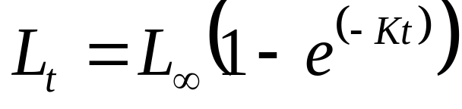
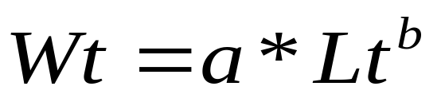
The length of the fish (L) at age t is calculated using a simplified (t₀ = 0) von Bertalanffy growth equation: where: L∞ is the maximum length, and
K is the instantaneous growth rate.
The weight of the fish (W) at age t is determined using a length-weight relationship.
where: a is the L-W unit conversion coefficient, and
b is the L-W growth factor

Slide 3
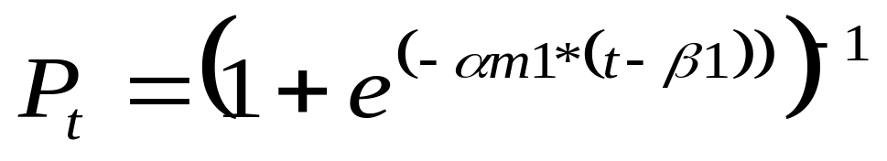
The percent maturity (P) of individuals in the cohort at age (t) is expressed using a LCDF:
where: αm1 is the steepness of the curve, and
β1 is the age at 50% maturity.

Slide 4
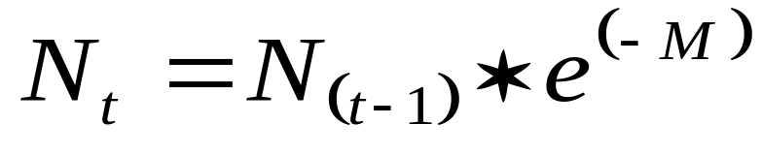
The number of individuals (N) remaining in the unfished cohort at age t is determined using the survival incremented at the time step of t years:
where: M is the instantaneous natural maturity,
N₀, the initial cohort size, is 1000 individuals at the start of the age 0 year

Slide 5
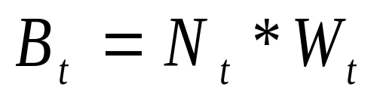
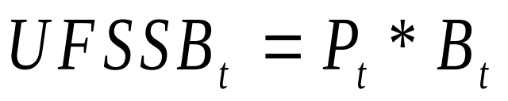
The biomass (B) of the individuals remaining in the unfished cohort at age t is calculated:
The unfished spawning stock biomass (UFSSB) of the individuals remaining in the cohort at age t is determined:

Slide 6
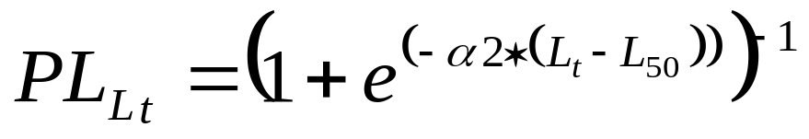
Recruitment to the fishery is represented by LCDF, where the probability of selection (PL_{Lt}) by the gear is a function of fish length at age t
where: α2 = steepness of the curve, and
L50 = length at 50% selection.

Slide 7
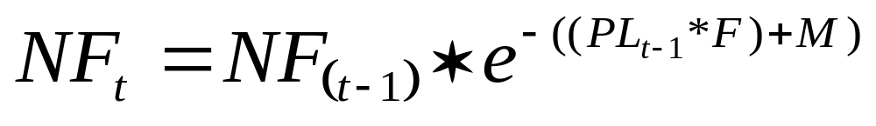
Applying length‑specific susceptibility to fishing (PL_{Lt}) at a specified level of fishing mortality (F) and using an assumed natural mortality (M), the number of individuals remaining in the fished cohort (NF) at each age (t) is calculated as:

Slide 8
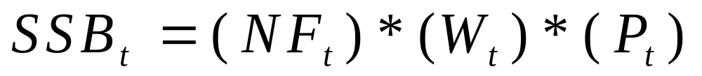
The yield of the fished cohort (Y_{t}) from each age t or time‑step is:
The spawning stock biomass of the fished cohort (SSB_{t}) at each age t or time step is:

Slide 9
Total YPR
YPR = Y/R =ΣY_{t} / N₀
Total SSBPR
SSBPR = SSB/R = ΣSSB_{t} / N₀
Use a Table Function to repeat the analysis for Fishing Mortality levels from 0.1 to 1.5 at intervals of 0.1

Slide 10
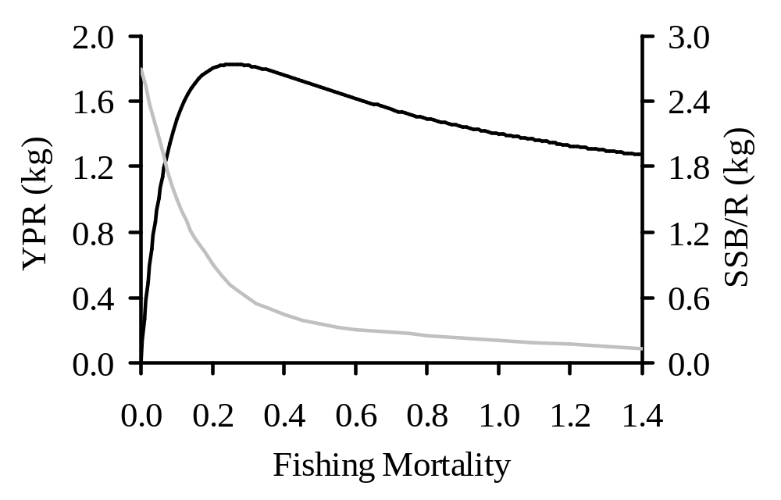
RESULTING PLOT OF YPR AND SSBPR AS A FUNCTION OF FISHING MORTALITY

